Slide 1
Senior Preceptor Workshop
Kate Demers Msc rm, Assistant Professor
Kathi Wilson MsC Rm, Assistant professor
Mcmaster University Midwifery Education Program

Slide 2
Introductions
Tell us about yourself
Where do you practice?
What is your experience with students?
What are you hoping to get out of this workshop today?

Slide 3
Objectives
To review the roles and responsibilities of a preceptor in the McMaster Midwifery Education Program
To review the structure of the Midwifery Education Program
To become familiar with the three courses in the senior year of clinical placement in the MEP
To develop knowledge about teaching, providing feedback and guiding students to learn clinical reasoning skills

Slide 4
What is a Preceptor?
An experienced practitioner who provides instruction and supervision during clinical practice and facilitates the application of theory to practice for students
The primary role of the preceptor is to facilitate learning by assisting the student to meet personal and course objectives. This requires preceptors to be able to provide the student with constructive feedback regarding questions, including positive reinforcement, and to take corrective measures as needed.
In the MEP, a preceptor is required to be a registered midwife in the general registrant category without restrictions or conditions.

Slide 5
Roles and Responsibilities of a Preceptor
Primary Preceptor
Provides continuity and consistency, monitors and ensures adequate caseload
Collates feedback from all those involved in supervising/teaching student
Organizes off-call time in conjunction with student, aware of workload
Aware of and communicates student learning needs, provides opportunities
Organizes and conducts mid-term and final evaluations in clinical placement
All preceptors
Provide a safe working environment for students, both from a workload and equity perspective.
Facilitate student learning
Provide teaching and support in a safe clinical environment
Provides feedback to student
Participates in preceptor education workshops

Slide 7
How do I fit into this?
What is different about being a senior preceptor?

Slide 8
Equity, Diversity, Inclusion
The Midwifery Education Program is committed to developing and promoting equity, diversity, and inclusion in every facet of the Program. We invite students to contribute by bringing forward equity, diversity, and inclusion issues for discussion and action in a climate of learning and respect.

Slide 10
Microaggressions
Definition: Describes interactions, whether intentional or not, that convey, in subtle but powerful ways, negative messages about specific groups of people.
https://www.youtube.com/watch?v=ZahtlxW2ClQ
Microaggressions create “extraneous cognitive load” which interferes with effective learning.
Resources:
Ackerman-Barger K, Jacobs NN. The microaggressions triangle model: A humanistic approach to navigating microaggressions in health professions schools. Acad Med 2020;95(12):S28-S32.
Wheeler DJ, Zapata J, Davis D, Chou C. Twelve tips for responding to microaggressions and overt discrimination: when the patient offends the learner. Med Teach 2019;41(10):1112-1117.

Slide 11
As well:
Gaslighting: a form of psychological manipulation that seeks to sow seeds of doubt in a person or persons by making them question their own memory, perception and sanity
Tone policing: a tactic used by those who have privilege or authority to silence those who do not by focusing on the tone of what is being said rather than the actual content.
-- Layla F. Saad, Me and White Supremacy

Slide 13
How can I combat implicit bias as a preceptor? What are my responsibilities as a preceptor?

Slide 14
This is not an exhaustive List…
Do not dismiss, diminish or ignore a student’s experiences of bias or discrimination – listen, lean into the conversation, and involve faculty.
Determine through open exploration if the student is safe. Listen to them if they say they are not.
Reflect on your own practice with a critical lens.
Take responsibility for educating yourself about those who are different from you, but do not put the onus on others to educate you.

Slide 15
Senior year Clinical Placements Complications/Consultations; maternal-Newborn Pathology; Clerkship

Slide 16
Student workload policies
Minimum 4 days off call/month (at least one weekend)
Academic study day: 24 hours off-call from Thursday 5 pm to Friday 5 pm
Off call 36 hours prior to mid-term exam, 72 hours prior to final exam
Average 20 clinic/community visits per week
Safe sleep policy: if a student has been awake for 24 hours, they must be off-call for the following 12 hours OR if student identifies that they are unable to function in a safe and competent manner due to fatigue, there must be action taken to rectify this and promote adequate rest.

Slide 17
Complications & Consultations
12 weeks in placement
≥ 12 planned primaries (min. 10 attended); ≥ 6 planned seconds (min 4, max 8 attended)
Minimum 14 births attended; maximum 22 attended.
NB: Intrapartum transfers of care may be counted as primary births, regardless of whether the student conducts the birth.
Weekly tutorial, written assignments and 2 examinations (mid-term and final)
May attend one postnatal visit independently (without preceptor present) after day 3 and before the discharge visit.

Slide 18
Complications & Consultations
displays an expanding base of knowledge about maternal and newborn conditions in situations outside of normal where consultation is required
demonstrates primary care responsibility in the provision of midwifery care
seeks advice and consultation from the supervising midwife as needed
demonstrates clinical decision making skills in normal situations with confidence and in situations outside of normal where consultation is required with minimal assistance
routinely initiates the planning of care and debriefs with preceptor
conducts prenatal and postnatal visits in normal situations with confidence and in situations outside of normal where consultation is required with minimal preceptor supervision
responds to pages and phone calls appropriately and provides clear information/direction to clients
manages normal labour and birth, including third stage, with confidence
manages labour and birth in situations requiring consultation with minimal assistance
identifies the need for intervention and/or consultation and participates in consultations with preceptor supervision
recognizes emergency situations and initiates care with preceptor assistance
establishes effective, professional relationships with clients, midwives, administrative staff, student midwives and other health professionals

Slide 19
Small group work
Based on the list on the previous page
What are some techniques you can use to help students learn these skills?
Where do you think students might struggle the most when learning these skills?
When you were a student was there a strategy that you used that worked to help you learn a more difficult skill?

Slide 20
Maternal-newborn pathology
13 weeks in placement
≥ 12 planned primaries (min 10 attended); ≥ 6 planned seconds (min 4, max 8 attended)
Minimum 14 births attended; maximum 22 attended
Weekly tutorials, written assignments and two exams (midterm and final)
May attend two postpartum visits independently (without preceptor present), after day 3 and before the discharge visit
May attend as second midwife at hospital births

Slide 21
Maternal newborn pathology
behaves in a professional manner at all times during placement
conducts prenatal and postnatal visits without assistance except when unusual conditions present;
routinely initiates the planning of visits and debriefs with her preceptor;
provides intrapartum care, recognizes abnormal situations and plans management;
seeks advice from the supervising midwife as needed;
displays an expanding base of knowledge about maternal and newborn conditions;
responds to pages appropriately;
establishes good working relationships with midwives, admin staff, clients and other health professionals;
recognizes the need for and performs emergency skills with assistance;
able to practice full scope midwifery.

Slide 22
clerkship
13 weeks in placement
≥ 12 planned primaries (min 10 attended); ≥ 8 planned seconds (min. 6, max 10 attended)
Minimum 16, maximum 24 births attended
Bi-weekly tutorial (but weekly academic work day), assignments and two exams.
May attend three independent postpartum visits (without preceptor present) after day 1 and before the discharge visit
May be the second midwife at both hospital and home births.

Slide 23
Clerkship
Demonstrates appropriate professional behaviour toward clients and colleagues and behaves in a professional manner at all times.
Is confident, competent and consistently able to function independently in the provision of midwifery care;
Conducts comprehensive prenatal, intrapartum, postnatal and newborn care;
Identifies abnormal situations and deviations from normal and institutes appropriate management strategies;
Responds appropriately in emergency situations;
Initiates and completes appropriate discussions, consultations and transfers of care;
Provides comprehensive, thorough and appropriate information;
Provides comprehensive, thorough and appropriate documentation of her observations;
Demonstrates appropriate and professional responsibility for learning

Slide 24
Covid considerations
Complications and Consultations students are not to be involved in the care of presumed or confirmed positive COVID clients.
Maternal-Newborn Pathology and Clerkship students may be involved in the care of presumed or confirmed positive COVID clients, as they are able to be one of two midwives at a birth.
Virtual visits – a specialized skill for students to develop; these visits count as an antenatal visit (for continuity purposes) unless a physical assessment component is included.
Students will be provided with adequate PPE from the MEP and receive donning and doffing training prior to clinical placement.
Informed about policies regarding reporting exposure, but adhere to local policies regarding self-isolation vs continuing to work post-exposure

Slide 26
Preparation and orientation

Slide 27
Preparation
Inform clients in advance of student participation (post announcements in public areas of the practice – clinic rooms, bathrooms, waiting rooms; put information on the practice website, e.g. https://tvm.on.ca/our-students/ )
Clients should know that they can decline student participation, but “selling” clients in advance of the student arriving about the benefits of having student involvement (e.g. labour support) and the interactions between student and preceptor will minimize those who decline.
Discuss caseload planning prior to student’s arrival
Discuss how midwife preceptors in a shared care model will function with the student (e.g. who is the primary preceptor, how communication about off-call time, learning needs, etc. are shared)
Plan for teaching time and workshops (e.g. simulations for emergency skills, suturing, venipuncture)
Discuss how student feedback will be collated and tracked
Familiarize yourself with key MEP documents – Policy and Information Handbook; Guide to Teaching and Learning

Slide 29
Orientation
Practice:
Administrative staff and processes
Midwives – model of practice and call schedule
Health records (paper? EMR – student access?)
Physical space and parking
Practice protocols
Equipment and supplies
Conflict resolution process
Hospital (s)
Birth unit tour
Obtaining ID
Health records (access to EMR/training)
Parking
Supplies and equipment

Slide 30
orientation
What does your practice already do?
Is there anything you would like to see implemented at your practice?
What do you remember about orientation to a new practice as a student or midwife?

Slide 31
Teaching Strategies

Slide 32
Characteristics of effective preceptors
Welcoming
Organized
Provide feedback
Enthusiastic
Set clear expectations
Knowledgeable
Open to learning

Slide 33
Effective teaching in the clinical setting
Teaching in clinical education occurs as a spectrum of types of teaching that change over time and with the complexity of the skill
Precepting spectrum:
Directing/modelling
Coaching
Supporting/scaffolding
Delegating

Slide 35
Clinical Reasoning
Single greatest challenge and most important skill for midwifery students to acquire
“Care management”, “care planning”, “the big picture”
Involves knowledge base, critical thinking, problem-solving
“Situated” and “context-dependent”
Developed from novice to expert
Complex process that is heavily researched and not yet entirely well-understood

Slide 36
Clinical reasoning – But, how do I Teach this?
Modelling – talk out loud while you’re thinking about a clinical situation. Slow down – what is automatic to you may not be obvious to the student.
Provide a safe environment for the student to perform clinical reasoning with you; they are students and will not always have an answer, but *will* learn from mistakes.
Encourage reflection on action and reflect/debrief with the student – sooner rather than later
Algorithms and task lists can help, but students will need to learn to individualize these to each client’s care
Recognize that “transfer is difficult” – it is difficult to translate knowledge into action, especially for novices
Review interesting past cases with students.

Slide 39
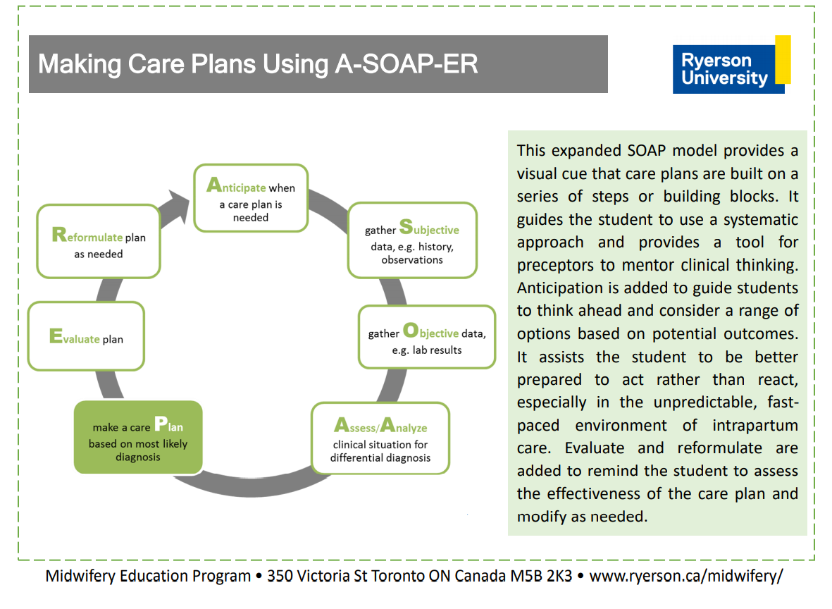

Slide 40
Clinical reasoning
What do you recall about learning to master this skill?
What are the challenges that you think you will encounter?
What does success look like?

Slide 42
Feedback and assessment
Feedback is:
Formative
Not assessment OF learning but assessment FOR learning
Low stakes for the learner
Non-judgmental
Coaching and supportive of improvement
Occurs in a “feedback culture”; “culture of improvement rather than culture of performance”
Provided in a timely fashion

Slide 44
Prerequisites for effective feedback
Longitudinal relationship
Relationship of trust – creating psychological safety for learners to engage with feedback
Respect (respect, respect) and honesty
Multisource, if possible
An environment in which learners can explore and feel “safe to fail” in individual performances and performance attempts.

Slide 45
Providing effective feedback
Timeliness is paramount: not too fast, but certainly not too late
Environment is important: in front of a client *may* be okay, but privacy is often best, especially if feedback is corrective
Encourage the learner to reflect on performance:
“How did that feel for you?”
“Is there anything that you think you could do differently?”
Reflection is not the same as self-assessment (which is not done well by anyone)

Slide 47
Providing effective feedback
Provide information in small amounts directly related to the performance (2 – 3 points)
Set goals for improvements (“Next time let’s see if you can…”) and make sure they are achievable
Ask the learner how they think they might improve, or what might help them improve
Follow-up on feedback
Do not engage in feedback when you and/or learner are fatigued and/or stressed!

Slide 48
Remember….

Slide 49
Clinical Evaluation
Student is responsible for organizing clinical evaluation at midterm and final in collaboration with preceptor and tutor
Conducted on telephone with tutor, student & preceptor
Preceptor & student MUST meet and complete evaluation PRIOR to meeting with tutor.
McMaster students require MedSIS evaluation – done on line
An email will be sent to you from Kelly Edge with the link to the evaluation
Be sure to click “save” while working on the evaluation
Click “submit” after meeting with the student

Slide 50
Grades in clinical courses
Courses are satisfactory/unsatisfactory
>70% on tutorial work
>70% on exam (midterm & final)
Satisfactory in placement
Assigning the grade
Tutor, preceptor, student meeting
Satisfactory/Unsatisfactory/(Provisional Satisfactory – Final Evaluation only)
Tutor is ultimately responsible for the grade assigned.

Slide 51
Clinical evaluation
Satisfactory:
Student meets the benchmarks described previously in presentation. There may be isolated instances of learning needs (at the C&C or MNP level) or lack of opportunity which could reasonably be resolved in the next clinical placement.
Unsatisfactory:
Multiple learning needs/ performance deficits. Concrete examples are required and should be documented. If it is anticipated that the student is not performing satisfactorily, at any point in the placement, contact the tutor. Problems are best addressed early.
Provisional Satisfactory:
May only be assigned at final evaluation when there are discrete learning needs which the preceptor and student feel can be accomplished in a 4 week remedial placement
Even when the grade is satisfactory, make detailed notes on the Evaluation form. If it is not, documentation is of highest importance.

Slide 52
challenges

Slide 53
professionalism
Professionalism is an essential set of attitudes and behaviours expected of midwives throughout all stages of their careers, including their time as learners. As members of a self- regulating profession, midwives are entrusted to maintain professional accountability to themselves, clients in their care, colleagues, and their profession.
- Ontario Midwifery Education Program Student Guide to Professionalism
Examples of lack of professionalism include:
Inappropriate use of social media postings
Racist, homo/transphobic, ableist language or other comments indicative of bias or discrimination
Lying/dishonesty
Disrespectful behaviour with midwives, administrative staff, hospital colleagues, or clients
Failure to take responsibility for their actions within their scope as a student.

Slide 54
The learner in difficulty
Affective disorder – trouble handling important and new events
Cognitive disorder – trouble with written or oral communication, integration of material
Structural disorder – difficulty structuring experience (time management, organization)
Interpersonal disorder – difficulties interacting with others, poor social skills

Slide 55
Strategies to support students
Gather data
Observe student, talk to others
Reflect on your own teaching
Mismatch between expectations of teacher/learner, unclear goals
Discuss with student
Involve Tutor
Design intervention plan
Identify the issue, outline specific activities & timelines, agree on expected outcomes
Write it down!

Slide 56
WHAT OTHER CHALLENGES DO YOU ANTICIPATE WHEN WORKING WITH AND TEACHING STUDENTS?

Slide 58
AND, ONE LAST THING….
As a preceptor, you can apply for a “Adjunct Clinical Professor” position with McMaster
Benefits include online access to the McMaster library
Can add to your CV
Some hospitals now requiring this for credentialling
Contact Kelly Edge for more information

Slide 59
THANK YOU!!
Kelly Edge
kedge@mcmaster.ca
Kate Demers
kdemers@mcmaster.ca
Kathi Wilson
wilsonak@mcmaster.ca

